Slide 1

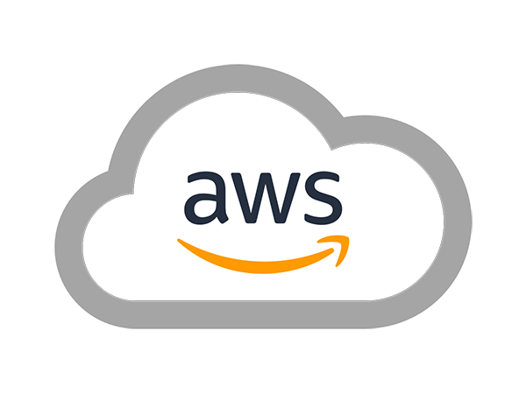
AWS SOLUTIONS ARCHITECT ASSOCIATE
Module 13:
AWS Risk and Compliance

Slide 2
Module Overview
Evaluating and Integrating AWS Controls
AWS Risk and Compliance Program
AWS Reports, Certifications, and Third-Party Attestations

Slide 3

Lesson 01: Evaluating and Integrating AWS Controls

Slide 4
Evaluating and Integrating AWS Controls
AWS IT Control Information
AWS Global Regions

Slide 5
Lesson 02: AWS Risk and Compliance Program

Slide 6
AWS Risk and Compliance Program
Risk Management
Control Environment
Information Security

Slide 7
Lesson 03: AWS Reports, Certifications, and Third-Party Attestations

Slide 8
AWS Reports, Certifications, and Third-Party Attestations
Criminal Justice Information Services (CJIS)
Cloud Security Alliance (CSA)
Cyber Essentials Plus
Department of Defense (DoD) Cloud Security Model (SRG)
Federal Risk and Authorization Management Program (FedRAMP)
Family Educational Rights and Privacy Act (FERPA)

Slide 9
AWS Reports, Certifications, and Third-Party Attestations
Federal Information Processing Standard (FIPS)
FISMA and DoD Information Assurance Certification and Accreditation Process (DIACAP)
Health Insurance Portability and Accountability Act (HIPAA)
Information Security Registered Assessors Program (IRAP)
ISO 9001

Slide 10
AWS Reports, Certifications, and Third-Party Attestations
ISO 27001
ISO 27017
ISO 27018
U.S. International Traffic in Arms Regulations (ITAR)
Motion Picture Association of America (MPAA)
Multi-Tier Cloud Security (MTCS) Tier 3 Certification

Slide 11
AWS Reports, Certifications, and Third-Party Attestations
NIST
PCI DSS Level
SOC 1/International Standards for Assurance Engagements No. 3402 (ISAE 3402)
SOC 2
SOC 3

